Slide 1


SAP S/4HANA Training
MASTER DATA GOVERNANCE (SAP MDG)
Neeraj Gupta
Session 02
SAP MDG – Introduction to Master Data Governance

Slide 2
Day 2 Agenda
2
SAP MDG – Introducing master data governance
Key Components
User Interfaces
MDG Applications
Use cases in MDG
MDG Standard Domains
MDG Architecture
Deployment Options
Customizing Synchronization
Demonstration – E2E Change request process

Slide 3
Business Scenario
2
SAP MDG – Introducing master data governance
Provides business processes to find, create, change, and mark master data for deletion
It supports the governance of master data on a central hub
Distribution of master data to connected operational and business intelligence systems
The processes are workflow-driven
Include several approval and revision phases, including collaboration between all users participating in master data maintenance

Slide 4
Key Software Components
2
SAP MDG – Introducing master data governance
Generic Services
MDG_APPL
MDG_FND
MDG_UX
UIMDG001
MDG_MDC
Roles/work centers
UI framework
Workflows
Change requests
Staging areas
Master Data Search
Data quality
Cleansing Cases
Analytics
Data replication import/export
Validation/enrichment adapter
key business functions
MDG_FOUNDATION
MDG_FINANCIALS
MDG_BUPA
MDG_ERP_SUPPLIER
MDG_ERP_CUSTOMER
MDG_MATERIAL
MDG_S4_FINANCIALS

Slide 5
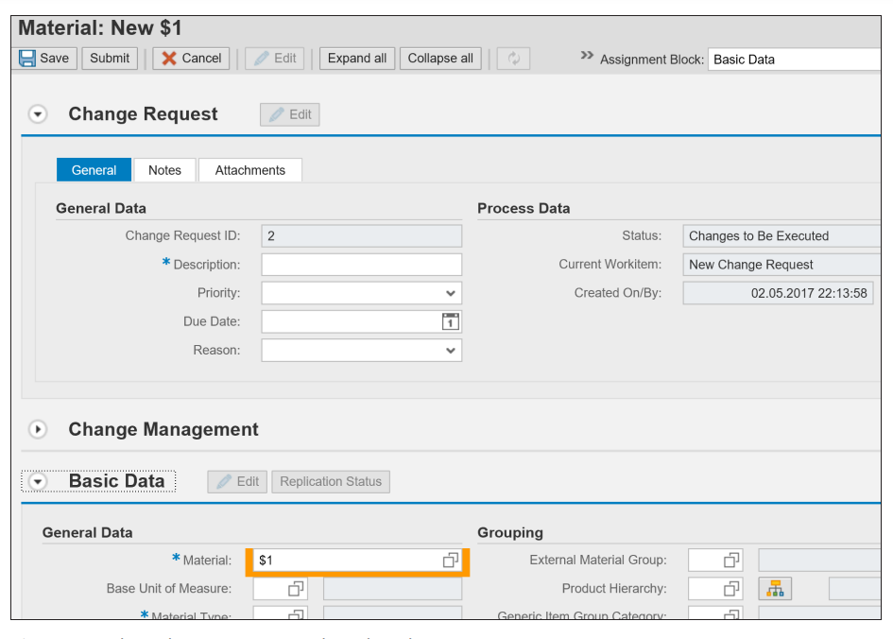
2
SAP MDG – Introducing master data governance
MDG User Interfaces
Floorplan Manager

Slide 6
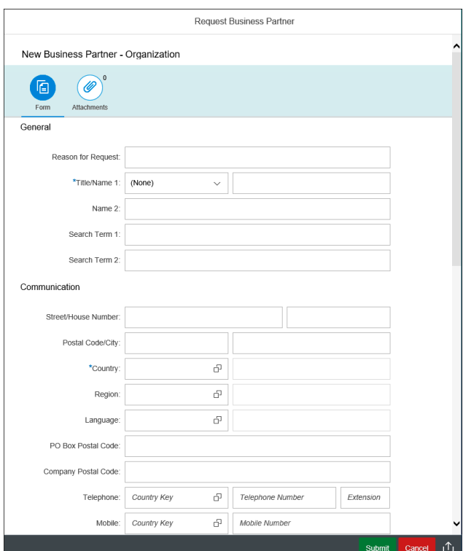
2
SAP MDG – Introducing master data governance
MDG User Interfaces
SAP Fiori Apps

Slide 7
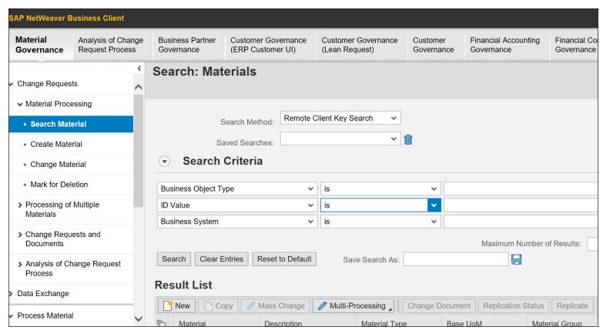
2
SAP MDG – Introducing master data governance
MDG User Interfaces
SAP Business Client

Slide 8
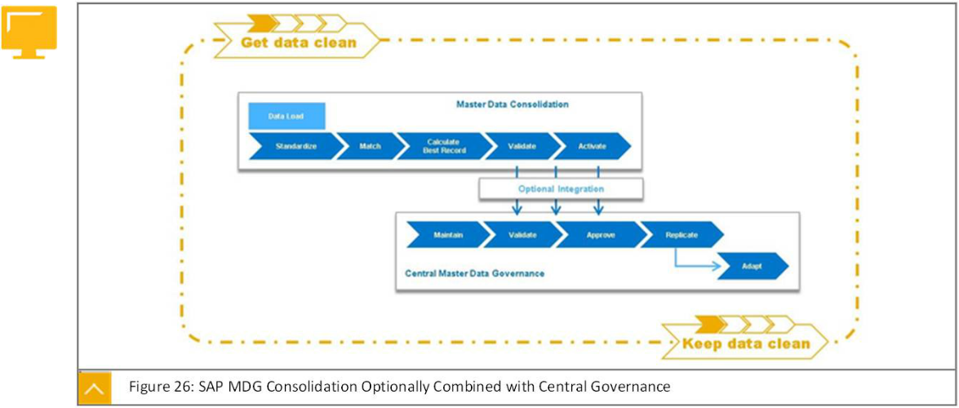
SAP MDG: Central Governance
2
SAP MDG – Introducing master data governance
MDG Applications

Slide 9
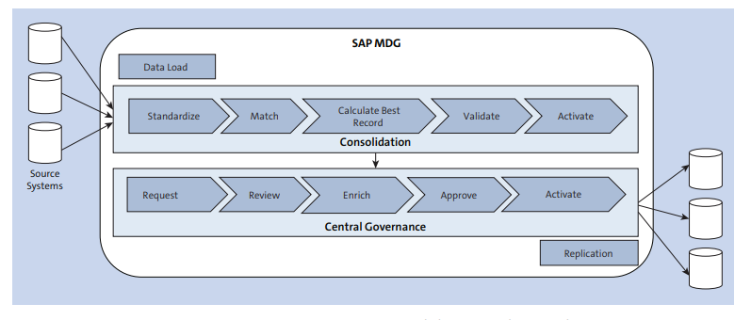
SAP MDG: Central Governance
2
SAP MDG – Introducing master data governance
MDG Applications

Slide 10
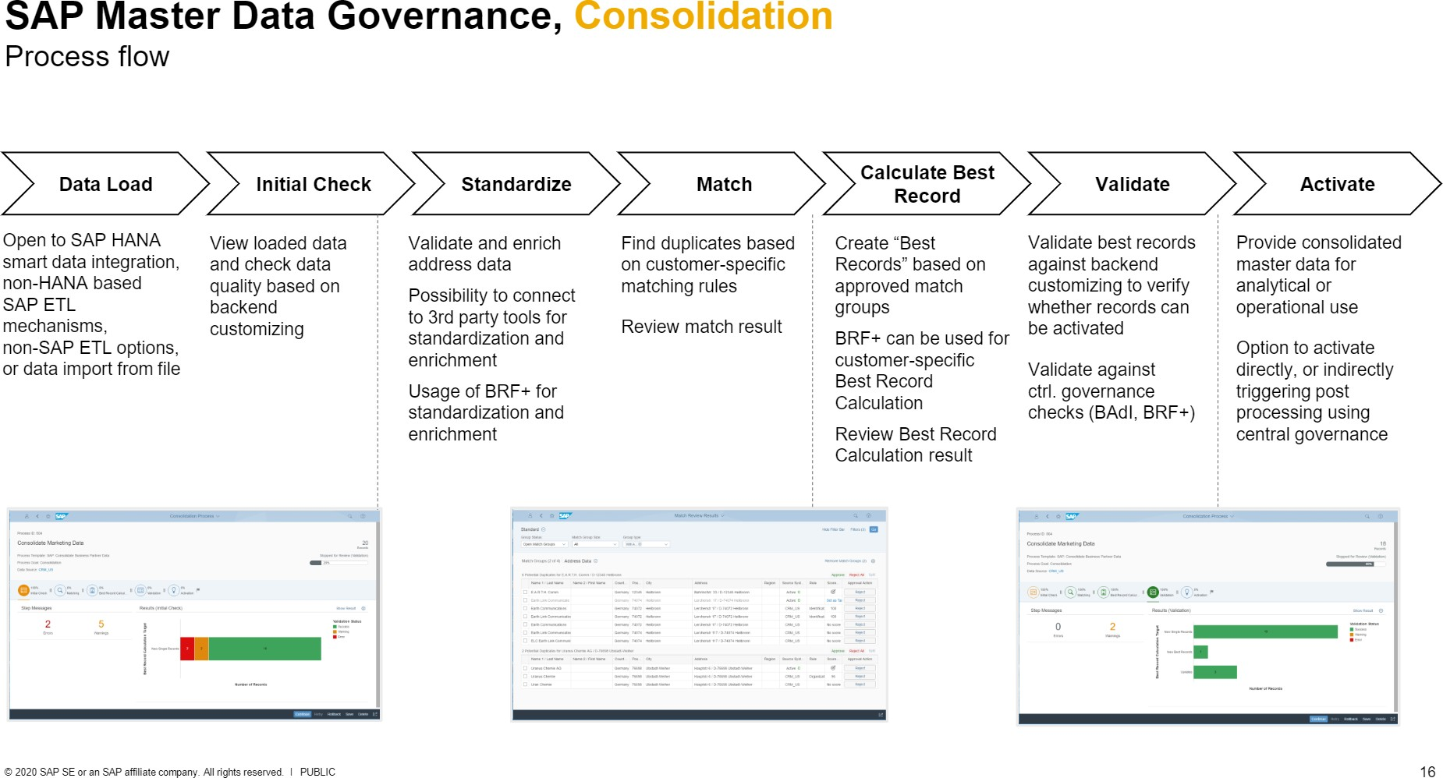
2
SAP MDG – Introducing master data governance
MDG Applications

Slide 11
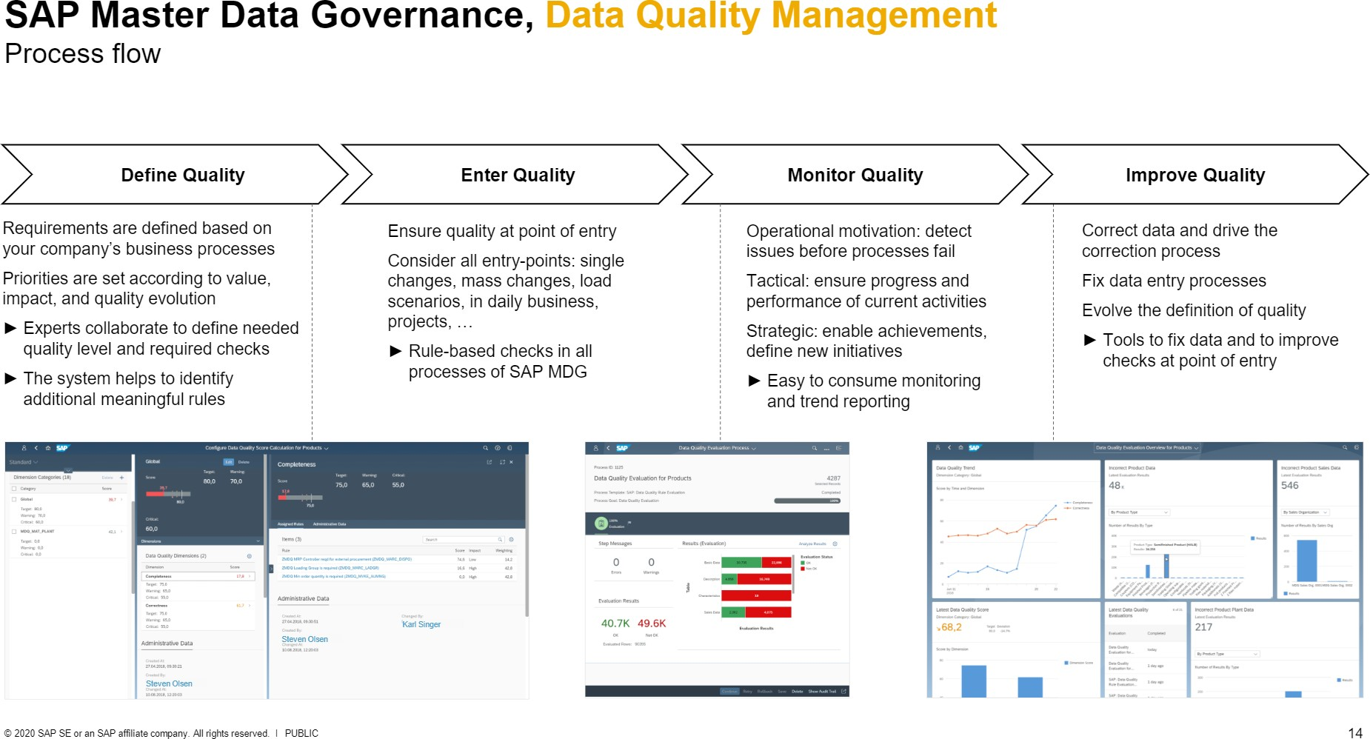
2
SAP MDG – Introducing master data governance
MDG Applications

Slide 12
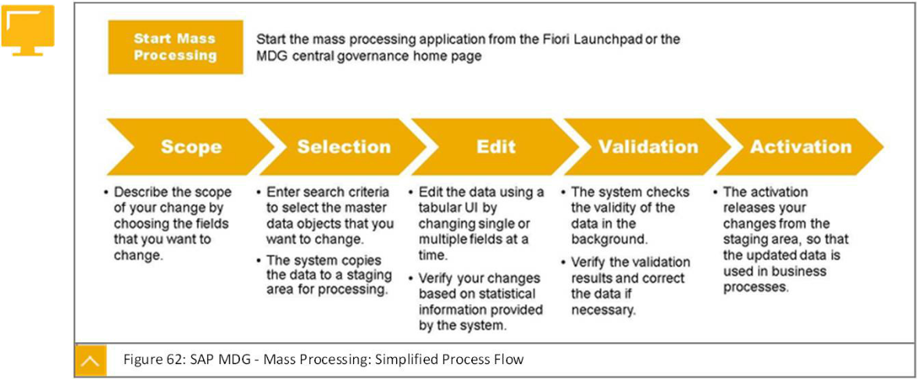
Mass processing
2
SAP MDG – Introducing master data governance
MDG Applications

Slide 13
2
SAP MDG – Introducing master data governance
MDG Use Cases
Central Governance
Audit Trails
Key mapping

Slide 14
Consolidation for analytics purposes only
2
SAP MDG – Introducing master data governance
MDG Use Cases
Common Data Standards

Slide 15
Consolidation for initial load before central governance
2
SAP MDG – Introducing master data governance
MDG Use Cases
Extraction - Merged - Cleansed - Best record creation

Slide 16
2
SAP MDG – Introducing master data governance
MDG Use Cases
Consolidation for mergers and acquisitions
Consolidation can be used to harmonize and de-duplicate the new data with the existing data
Continuous hybrid approaches

Slide 17
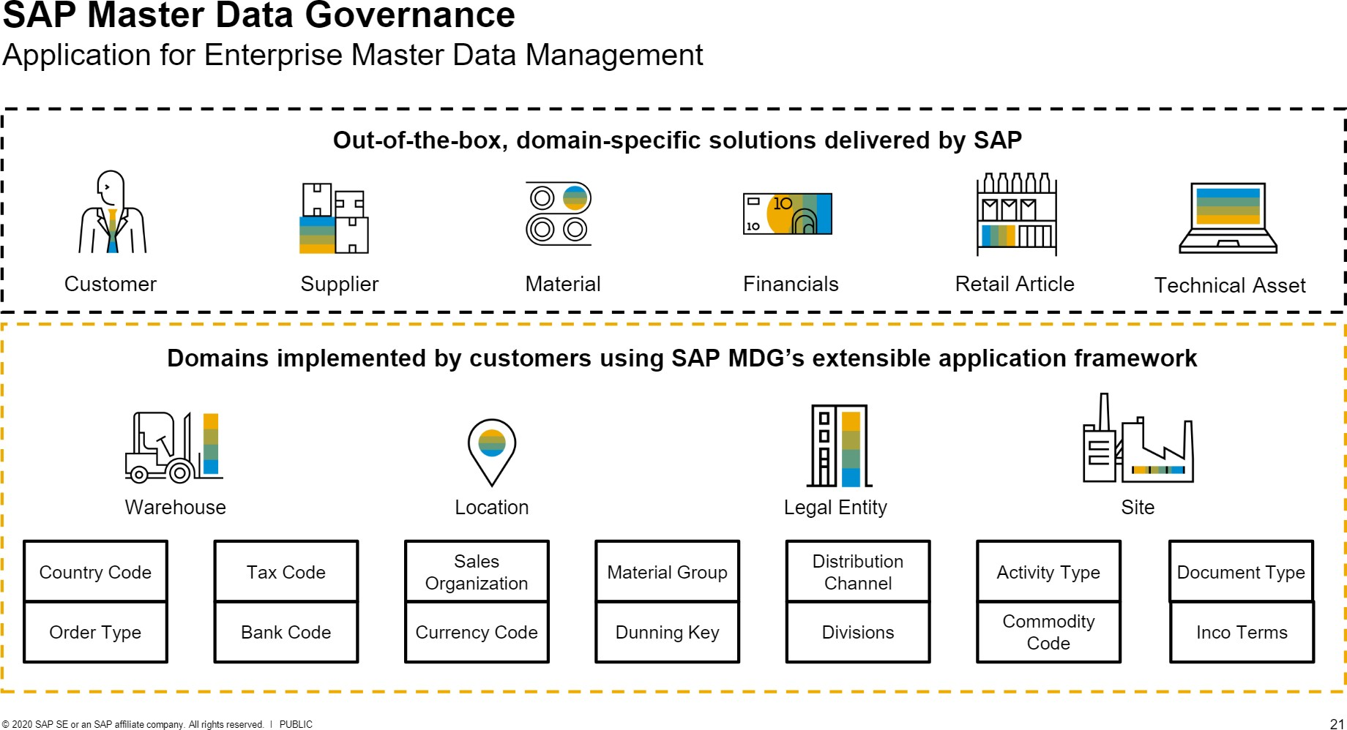
2
SAP MDG – Introducing master data governance
MDG Standard Domains

Slide 18
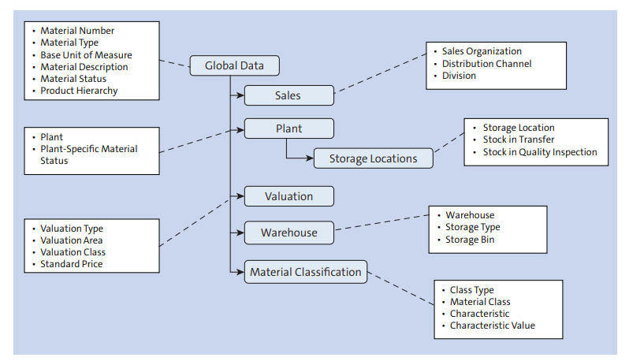
2
SAP MDG – Introducing master data governance
MDG Standard Domains
Material Master Overview

Slide 19
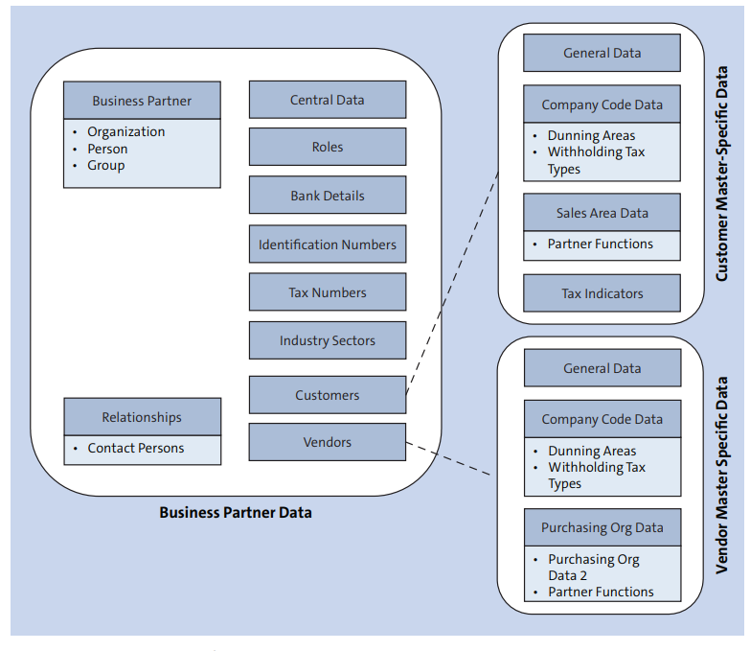
2
SAP MDG – Introducing master data governance
MDG Standard Domains
Business Partner Overview

Slide 20
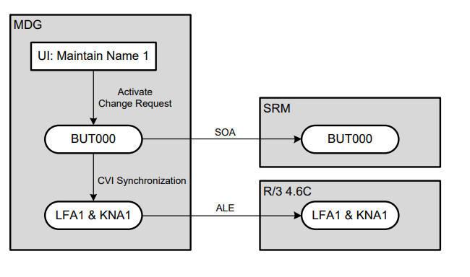
2
SAP MDG – Introducing master data governance
MDG Standard Domains
Customer / Vendor Integration (CVI)
Synchronize parts of the business partner master data with the related ERP customer and supplier master data and vice versa
General Data
o Names
o Search Terms
o Trading Partner
o Business Partner Category
Address Data
Only the standard address is synchronized
Communication Data
Only address dependent communication data
Bank Accounts
Industry Sectors
Only the standard industry sector is synchronized
Tax Numbers

Slide 21
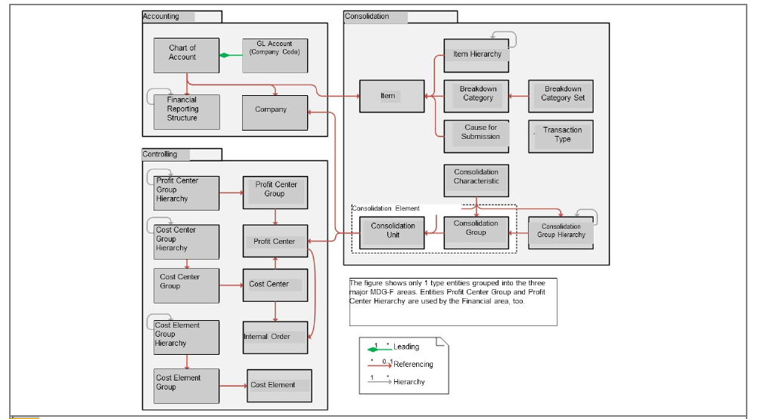
2
SAP MDG – Introducing master data governance
MDG Standard Domains
Financial Objects Overview

Slide 22
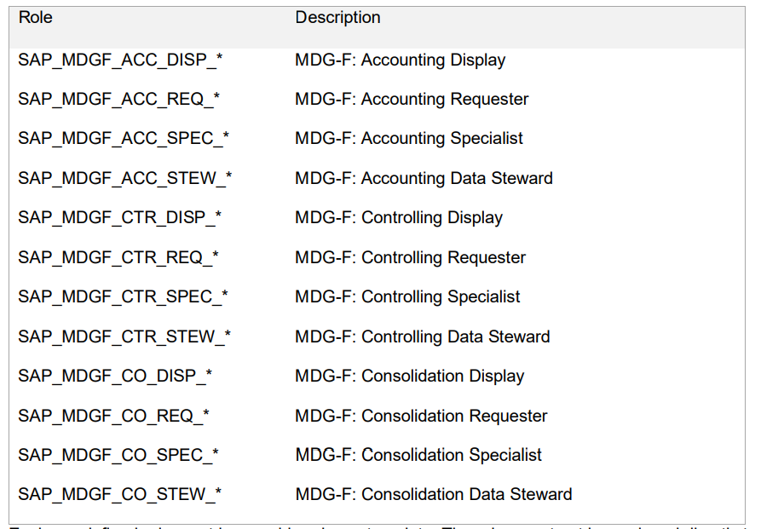
2
SAP MDG – Introducing master data governance
MDG Standard Domains
Financial Pre-defined Role Objects Overview

Slide 23
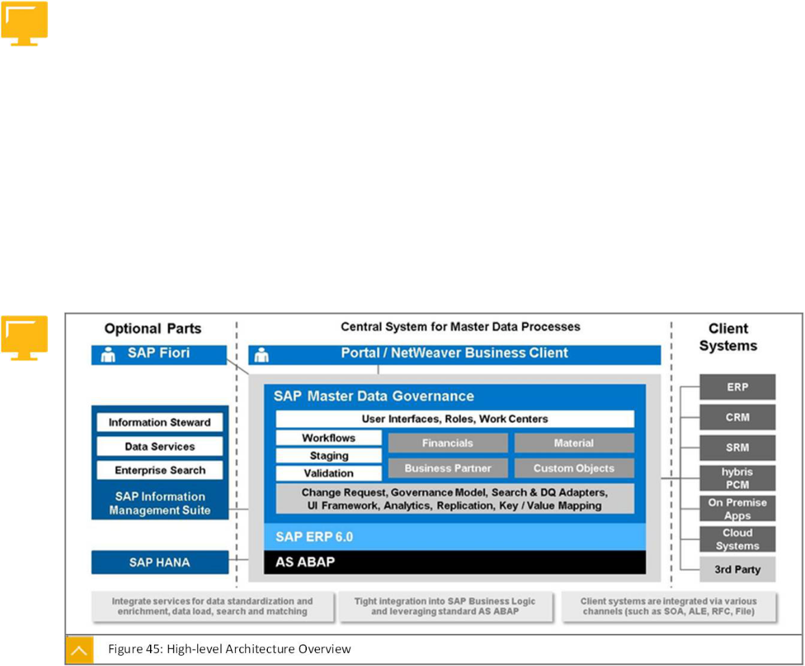
2
SAP MDG – Introducing master data governance
MDG Architecture

Slide 24
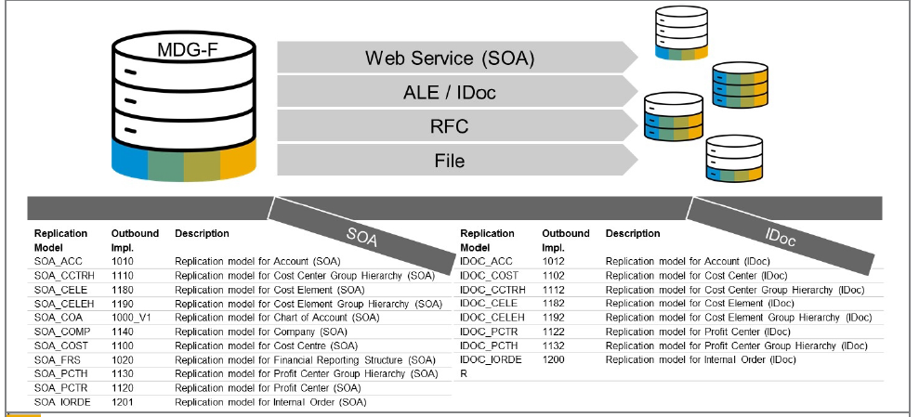
2
SAP MDG – Introducing master data governance
MDG Replication Technologies

Slide 25
2
SAP MDG – Introducing master data governance
MDG Deployment Options
Hub approach vs Co-deployment approach
Customizing Synchronization
Reference Master Data Synchronization

Slide 26
2
SAP MDG – Introducing master data governance
MDG Deployment Options
Hub approach vs Co-deployment approach (Customizing synchronization Approach)
1. Business configuration sets (BC Sets)
2. Customizing Transports (TMS Framework)
3. SAP Solution manager (Automated Option)
a. Customizing Distribution
b. Customizing Scout
c. XLD (Focused Build standalone extension (using workbench requests and Change Request Management)
4. ALE Customizing Distribution (Also for REF master data sync.)
5. System / client copy with customizing data (Restricted)
6. Choice of Database in ERP (ECC) system

Slide 27
2
SAP MDG – Introducing master data governance
MDG Deployment Options
Hub approach vs Co-deployment approach (Customizing synchronization Approach)
1. Initial Synchronization
2. Ongoing synchronization
Semi-automatic synchronization
Custom solution
ALE-Based Customizing Distribution
SAP Solution Manager Based Customizing Distribution

Slide 28
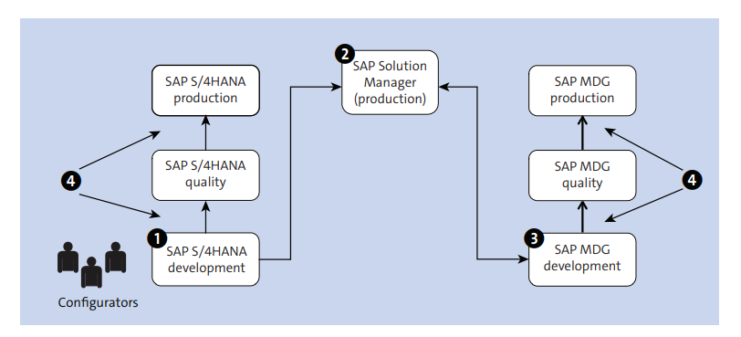
SAP solution manager based customizing process for ongoing synchronization
2
SAP MDG – Introducing master data governance

Slide 29
2
SAP MDG – Introducing master data governance
Customizing synchronizing setup

Slide 30
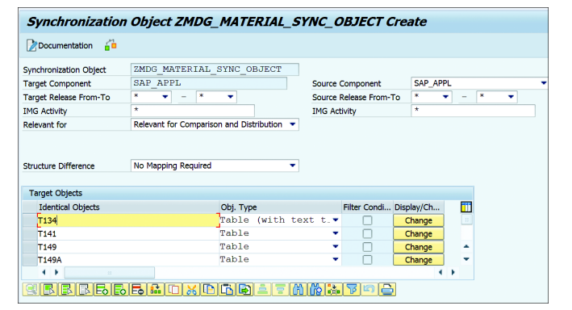
2
SAP MDG – Introducing master data governance
Synchronizing Object creation

Slide 31
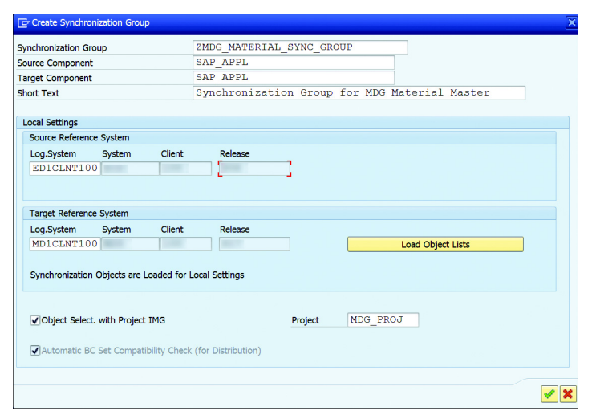
2
SAP MDG – Introducing master data governance
Synchronizing Group creation

Slide 32
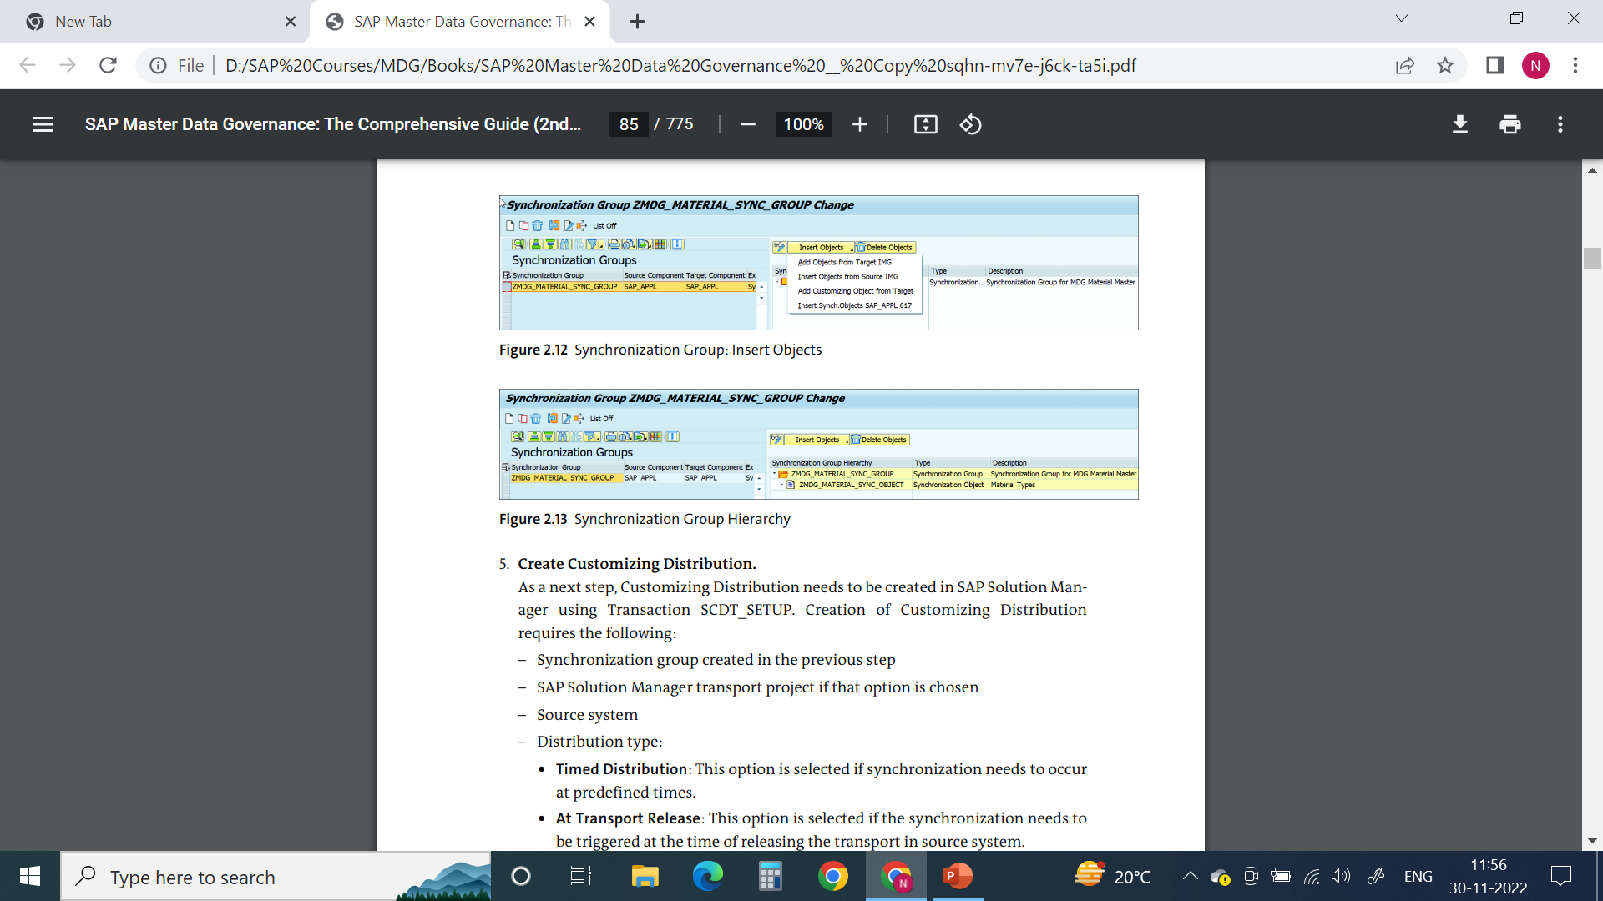

2
SAP MDG – Introducing master data governance
Synchronizing Group : Insert Objects
Synchronizing Group Hierarchy

Slide 33
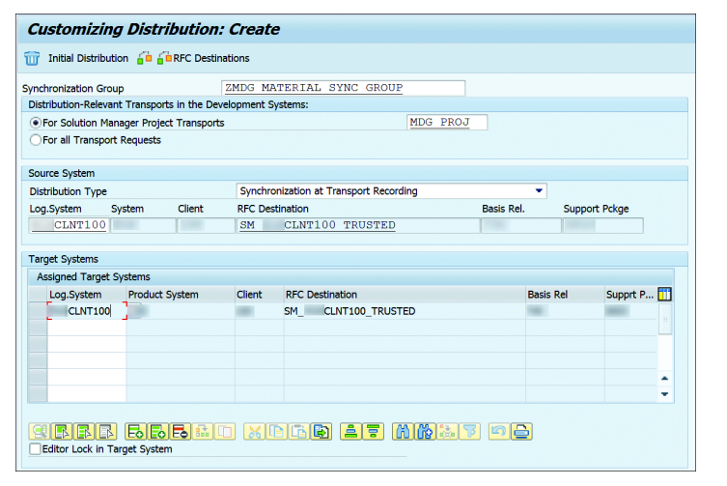
2
SAP MDG – Introducing master data governance
Customizing Distribution

Slide 34
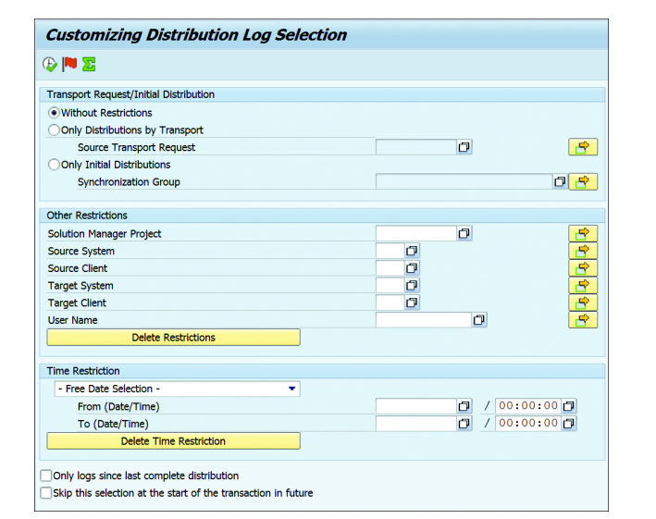
2
SAP MDG – Introducing master data governance
Distribution Log: SCDT_LOG

Slide 35
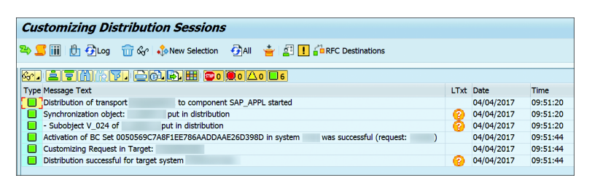
2
SAP MDG – Introducing master data governance
Distribution Log example

Slide 36
2
SAP MDG – Introducing master data governance
Customizing Scout

Slide 37
2
SAP MDG – Introducing master data governance
Customizing Scout comparison based on synchronization group

Slide 38
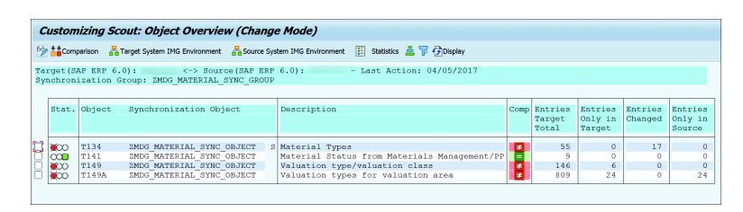
2
SAP MDG – Introducing master data governance
Customizing Scout comparison result: example

Slide 39
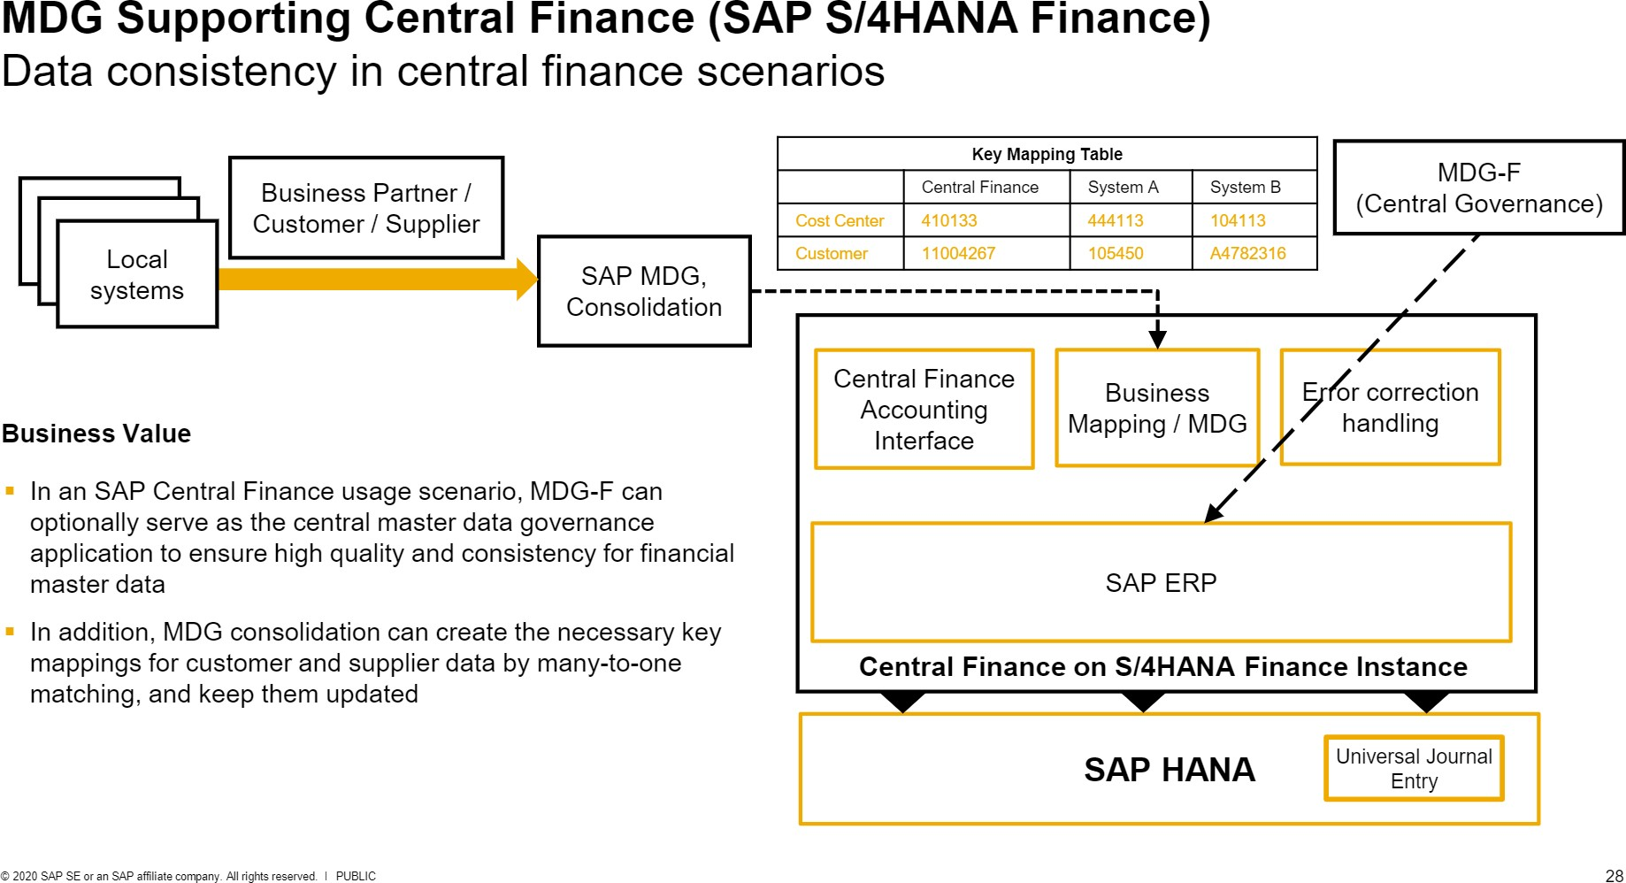
2
SAP MDG – Introducing master data governance

Slide 40
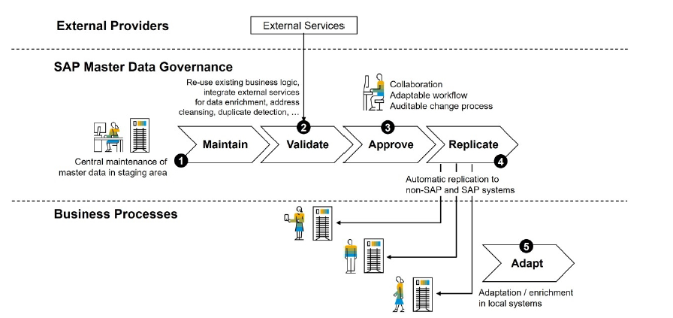
2
SAP MDG – Introducing master data governance
Demonstration: MDG Process Flow

Slide 41

End of Session 02

Slide 42

Questions

Slide 43

Neeraj gupta

Slide 44


We’re committed to empower you to be
Most Desirable Resource
through powerful training solutions.
We build the workforce of the future.
250+
Corporate Clients
30,000+
Learners Trained
25000+
Learners Placed
FREE WEBINARS
Sign up for free webinars with industry experts every fortnight!
Enroll Now!
Contact us today!
https://anubhavtrainings.com/

Slide 45




More from AnubhavTrainings.com

